Slide 1
Chapter 2 Instructions- Language of the Computer

Slide 2
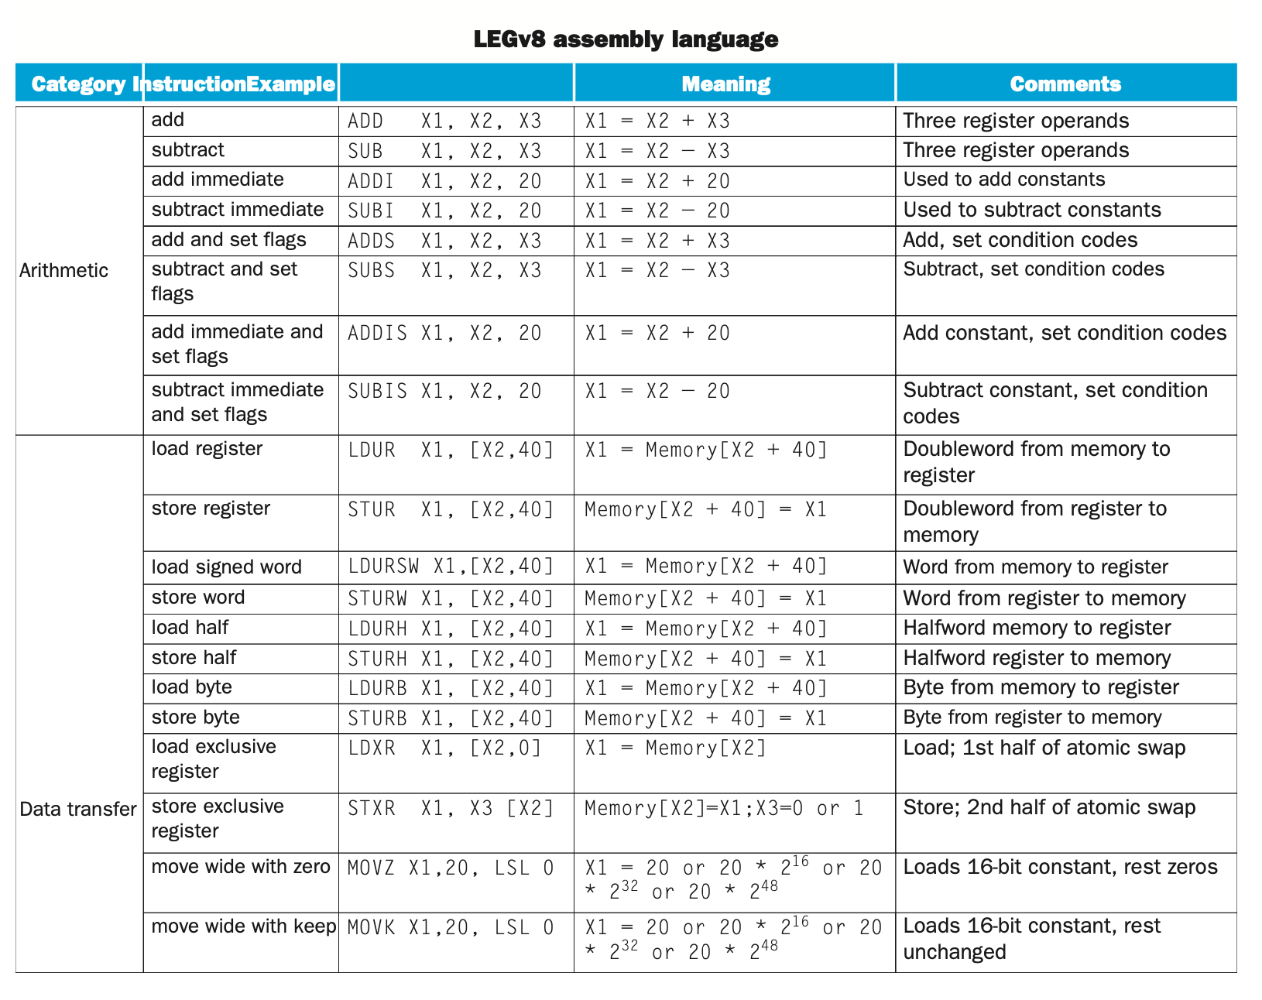
Basic Instructions

Slide 3
Some of the ARM instructions
ADD,SUB,ORR,AND | R | 11 | 10001011000
ADDI | I | 10 | 1001000100
ADDIS | I | 10 | 1011000100
ADDS | R | 11 | 10101011000
B | B | 6 | 000101
B.Cond (LT,LE,EQ,NE,GT,GE) | CB | 8 | 01010100
BL | B | 6 | 100101
BR | R | 11 | 11010110000
CBNZ | CB | 8 | 10110101
CBZ | CB | 8 | 10110100
LDUR | D | 11 | 11111000010
LDUR,B,D,H,S | D | 11 | 00111000010
LSL,ASL | R | 11 | 11010011011
LSR,ASR | R | 11 | 11010011010
STUR,B,D,H,S | D | 11 | 11111000000

Slide 4
Instruction Set Requirements
To develop an instruction set architecture you need
Means to interact with data
Registers fast, expensive and temporary
Memory slow, cheap and longer term
Variables with types
Strings: at the end of the day everything is 1s and 0s but we can treat them also as text
Numbers
Decimals int, long, short, byte, long longs, signed, unsigned
Floats single and double

Slide 5
Instruction Set Requirements
To develop an instruction set architecture you need
Operators
Mathematical Add, Sub, Div, Mul, Sqrt
Logical OR, AND, EOR, NOT, Shift left and right
Control Structures
Decision making compare Less than, Equal, Not Equal, Greater than
Looping branching

Slide 6
Data Stores – Registers – VERY short term
ARM provides registers of different types to support your application. Limited fast access data storage
X 64 bit Integers
W 32 bit Integers
S Single precision (32 bit) floating point
D Double precision (64 bit) floating point
V Vector arrays 128 bit words

Slide 7
Data Stores – Long term
Memory
Slower access
Cannot be acted upon directly
Must load from memory to a register
Operate on data
Store back to memory

Slide 8
Variables
Programming languages like ‘C’ depend upon variables to perform the transactions required by the app
All data is 1s and 0s but how we treat those 1s and 0s allows us to develop apps that are text or number based

Slide 9
Text Based
ASCII defines the standard to encode 1s and 0s to represent text
0x41 ‘A’ 0x61 ‘a’
0x20 space 0x30 – 0x39 ‘0’ – ‘9’
0x40 ‘@’ 0x2B ‘+’

Slide 10
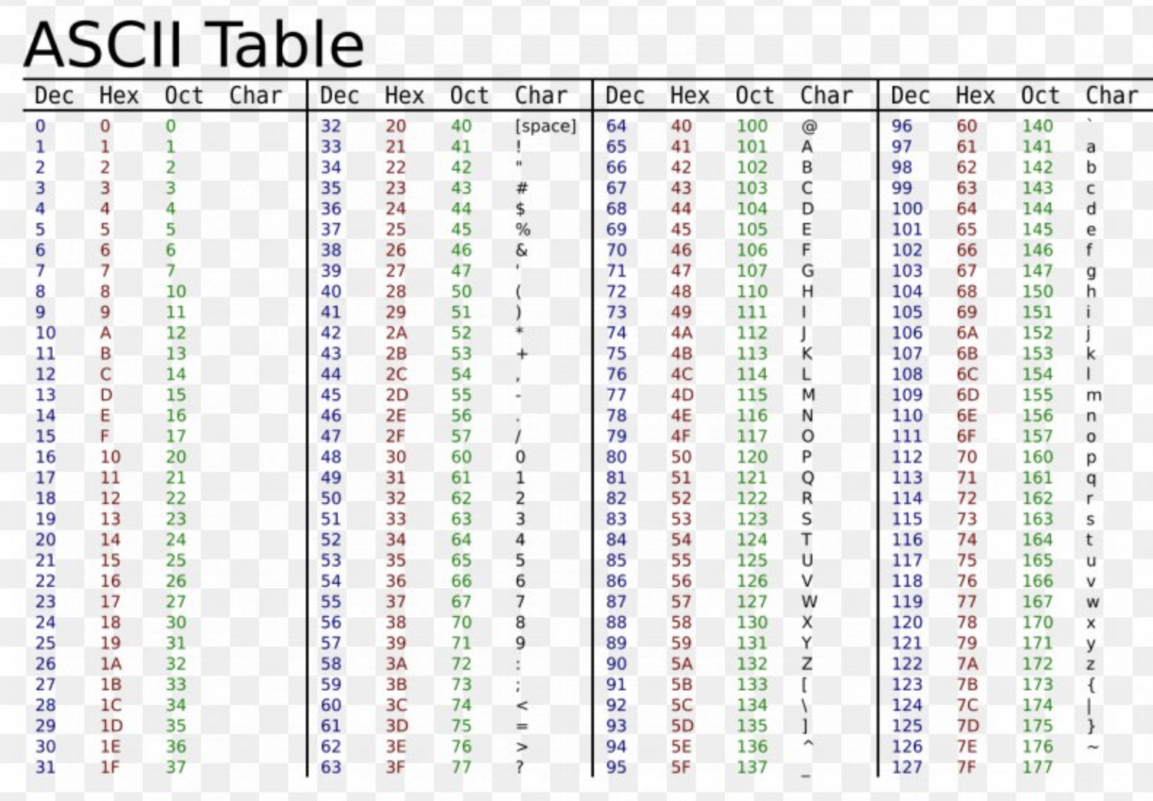
Encoding Text

Slide 11
Business and Scientific Based
Integers 8, 16, 32, 62 bits
each has supporting registers.
(let’s pretend we are on an 8-bit computer)
10 0000 1010 0x0A
129 1000 0001 0x81 (for an unsigned integer)
-127 1000 0001 0x81 (for a signed integer)
Floats 32, 64 bit with supporting registers
3.141592654
01000000010010010000111111011010
0x40490FDA

Slide 12
Instructions to operate on data
Data must first be retrieved from memory and saved to a register
// Convert Fahrenheit to Celsius
ADRP X2, fahr // Get mem addr of fahr
ADD X2, X2, :lo12:fahr // Normalize addr
// copy temperature to Reg. S2
LDUR S2, [X2, #0] // temp is a FP num

Slide 13
Instructions to operate on data
Operations are done between two registers or one register and a constant value
FMULSI S2, S2, #9 // multiply temp by 9
FDIVSI S2, S2, #5 // divide temp by 5
Then the value is stored back to long term memory
ADRP X2, celc // Get mem addr of celc
ADD X2, X2, :lo12:celc // Normalize adrs
// save temperature to celcius memory location
STUR S2, [X2, #0]

Slide 14
What Just Happened?
Moving data to and from memory
Type of instruction used:
D Format Register to/from memory LDUR X2, [X5, #16] // X2 = array[2] STUR X2, [X5] #32] // array[4] = X2
Working on Data
R (Register to Register)
ADD X4, X3, X2 // X4 = X3 + X2
I ‘Add’ Constant to a Register // or Sub, Mult, Div, OR, AND
ADDI X5, X5, #20 // X5 += 20

Slide 15
Note on ARM v. LEG opcodes
LEGv8
ADDI – Add immediate: (or whatever Opcode that ends with an I) second operand is a constant
FADD (floating point operator): implies Floating point registers
ARMv8
ADD is used for both regular ADD and ADDI
ADD is used to represent both Integer and floating point ADD

Slide 16
Change the course of your program flow
High-level languages have constructs to jump to different parts of the code or loop through portions.
If then else if else endif
Switch case
For
While
Do while
Call a procedure
At the end of the day these will degenerate down to a compare statement and a conditional branch
A Call statement is a specialized form of a branch

Slide 17
Making Decisions
Choosing path A or B
If (speed > 100) issue a ticket
To do this in Assembler we would do the following
ADRP X2, speed
ADD X2, X2, :lo12:speed
LDUR X1, [X2, #0]
SUBIS XZR, X1, #100
B.GE TICKET
SUBIS X1, X1, #75
B.LT EXIT
// Warning: code here to issue a warning
BR EXIT
TICKET:
// code here to issue a ticket
EXIT: // Exit applicaiton

Slide 18
Making lots of decisions
// Assume x0 holds the value to be switched on
SUBIS XZR, X0, #33 // Compare x0 with 33
B.LE SMALL // Branch if LE to SMALL
SUBIS XZR, X0, #66 // Compare x0 with 66
B.LE MEDIUM // Branch if equal to MEDIUM
B LARGE // Branch if equal to LARGE
SMALL: // Code for case 0 to 33 goes here
B END_SWITCH
MEDIUM: // Code for case 34 to 66 goes here
B END_SWITCH
LARGE: // Code for case 67 and above goes here
B END_SWITCH
END_SWITCH: // Code after the switch statement goes here

Slide 19
ARM/LEG/RISC – side note
A subset, called LEGv8 (Lessen Extrinsic Garrulity), used throughout the book
There are some differences between LEGv8 and ARMv8 – only ARMv8 works on DS5
ARMV8 has many more instructions than LEGv8
Commercialized by ARM Holdings (www.arm.com)
Large share of embedded computer market (cell phones, tablet, cars, printers, cameras..)
Typical of many modern ISAs
See ARM Reference Data tear-out card
A new initiative to compete with ARM RISC V foundation → open source architecture
You do not have to pay to build hardware for RISC V instructions

Slide 20
Basic app with lots of comments
// data section of your program for static variables
// declare v as a data object
// v is an array with 3 elements
// initialize array elements to 1, 2, 3
// code starts here (code normally called text)
// declaring main as a globally visible function
// declare which instruction set we are using
// declaring main as a function – not a data item
//start of code for main
// get the address of variable v and store it in X0
// set runtime relocation of memory
// access data at memory location (X0)+#0 or v[0] and store inX1
// access data at memory location (X0)+#8 or v[1] and store inX2
// X1 = X1+X2 = v[0]+v[1]
// access data at memory location (X0)+#16 or v[2] and store inX2
//X1 = X1+X2 = X1 + v[2] = v[1]+v[2]+v[3]
The program in test.S file to be used in help lab
.data
.type v, %object
.size v, 3
v: .xword 1, 2, 3
.text
.global main
.arch armv8-a+fp+simd
.type main, %function
main:
ADRP X0, v
ADD X0, X0, :lo12:v
LDUR X1, [X0, #0]
LDUR X2, [X0, #8]
ADD X1, X1, X2
LDUR X2, [X0, #16]
ADD X1, X1, X2
Exit:

Slide 21
Same app but this time we will store the result
Slightly modified → store result
.data
.type v, %object
.type result, %object
.size v, 3
.size result, 1
v: .xword 1, 2, 3
result: .xword
.text
.global main
.arch armv8-a+fp+simd
.type main, %function
main:
ADRP X0, v
ADD X0, X0, :lo12:v
ADRP X3, result
ADD X3, X3, :lo12:result
LDUR X1, [X0, #0]
LDUR X2, [X0, #8]
ADD X1, X1, X2
LDUR X2, [X0, #16]
ADD X1, X1, X2
STUR X1, [X3, #0]
Exit:
The program in test.S file to be used in help lab
Note: byte = 8 bits
.data
.type v, %object
.size v, 3
v: .xword 1, 2, 3
.text
.global main
.arch armv8-a+fp+simd
.type main, %function
main:
ADRP X0, v
ADD X0, X0, :lo12:v
LDUR X1, [X0, #0]
LDUR X2, [X0, #8]
ADD X1, X1, X2
LDUR X2, [X0, #16]
ADD X1, X1, X2
Exit:
Result = v[0]+v[1]+v[2]

Slide 22
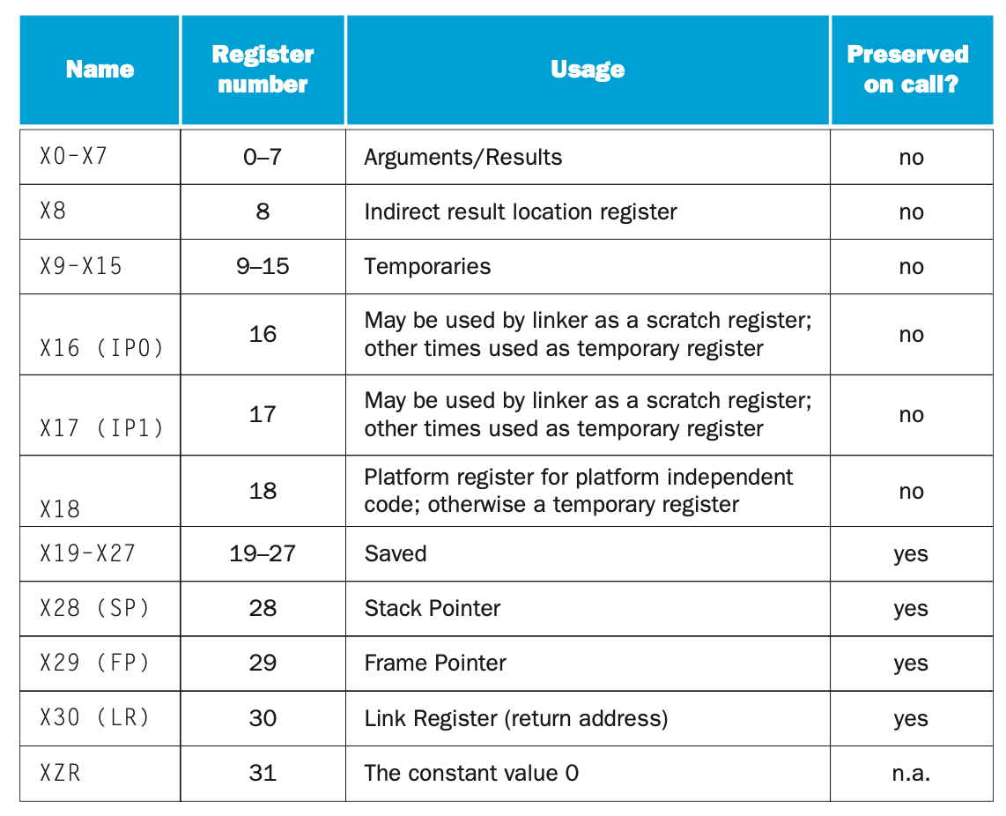
Register Usage
Remember X registers are 64 bit integer registers
There are W registers which are 32 bits

Slide 23
Registers
X0-X7 A procedure must save and restore any of these registers is uses
X9-X15 Do anything you want with them. Calling code does not expect these to stay the same after a procedure call
X19-X27 The Calling procedure expects these registers to be the same after the procedure call. Procedure must save and restore any of these registers that it uses
XZR, X31 Always zero, even if used as the destination register

Slide 24
Data Stores – Registers – VERY short term
ARM provides registers of different types to support your application. These limited fast access data storage
X 64-bit Integers
W 32-bit Integers
S Single precision (32-bit) floating point
D Double precision (64-bit) floating point
V Vector 25-bit (holds 4 array elements 4*64 bits)

Slide 25
Special Registers
These registers support the application and are not for ‘data’ storage
Program counter (PC)
What instruction comes next
Can be saved to bookmark a return point
When restored with a previous value program control advances to that location
Stack Pointer (SP, X28)
Points to the ‘top’ of the stack
Allocates memory space for procedures

Slide 26
Very Special ‘mini’ Registers
Condition codes hold the state the last instruction (if specified in the opcode)
SUBS, ADDS, ORRS, FMULS, LDURS
If it ends with an S you can be sure it is setting the condition codes
If it doesn’t end with an S do not follow instruction with a conditional branch
There are 4 condition codes (flags) we care about
N – Negative result
Z – Result was 0 (two operands are equal)
C – Overflow your unsigned result is greater than the register can hold
V – Overflow signed result is greater than the register can hold

Slide 27
Special Registers
Condition Code Registers: Save result of ADDS, SUBS, ORRS,… operations
SUBS X3,, X2, X1 // S Save conditions
If X3 is negative ➔ X2 < X1 → set N bit of the condition code register
If X3 is zero ➔ X2 = X1 → set Z bit of the condition code register
If X3 is positive ➔ X2 > X1 → implied by N=0
The condition codes will be → Negative, Zero, Positive, Carry Overflow
We can use these conditions in a branch
Branch if Negative B.LT
Branch if Zero B.EQ
Branch if Greater than or Equal B.GT

Slide 28
Condition Codes Don’t change until they change
Let’s compare two registers
SUBS XZR, X2, X3 // set CCs
B.GT BIG // CCs not changed
B.EQ SAME // CCs not changed
B.LT SMALL // CCs not changed
BIG: // code goes here
B EXIT
SAME: // code goes here
B EXIT
SMALL: // code goes here
B EXIT
EXIT:
All these will work off of the same compare

Slide 29
Stack Pointer
SP is at address 112
Procedure needs to store 3 registers (112 – 48 = 64)
SUB SP, SP, #48 // save 3 words on stack
STUR X30, [SP, #0] // Push return address
STUR X23, [SP, #16] // Push reg X23
STUR X12, [SP, #32] // Push reg X12
0
16
0
32
16
48
32
SP
64
48
80
Ret Adrs
64
????
96
X23
80
XXXXX
112
X12
96
YYYYY
SP
112

Slide 30
Stack Pointer
SP is at address 64
Procedure needs to restore 3 registers (112 – 48 = 64) and reclaim the space on the stack
LDUR X30, [SP, #0] // Pop return address
LDUR X23, [SP, #16] // Pop reg X23
LDUR X12, [SP, #32] ADD SP, SP, #48 // return stack to prev state
BR X30 // go home
0
16
0
32
16
48
32
SP
64
48
80
Ret Adrs
64
????
96
X23
80
????
112
X12
96
????
SP
112

Slide 31
Numbers – Unsigned Integers
Range 0 to 2^{n} – 1. If n = 8 max number is 2⁸ – 1
1111 1111 1 + 2 + 4 + 8 + 16 + 32 + 64 + 128 = 255
Only positive numbers 0001 1 1010 10 (xA) 0010 2 1011 11 (xB) 0011 3 1100 12 (xC) 0100 4 1101 13 (xD) 0101 5 1110 14 (xE)
1000 8 1111 15 (xF)

Slide 32
Numbers – Signed Integers
Range -2^{n-1} to 0 to TO +2^{n-1}–1.
If n = 8 -128 to 127
0111 1111 1 + 2 + 4 + 8 + 16 + 32 + 64 = 127
1000 0000 leading bit is a 1 so it is negative. So what is the value?
Use 2s Complement to negate a number (8 bit numbers)
Negate 2 What is this number?
0000 0010 1000 0001 // 2 and -127
1111 1101 0111 1110 // reverse all bits
+1 +1 // add 1
1111 1110 0111 1111 // -2 and 127 respectively

Slide 33
Max Range
Unsigned 32 bits 0 to +4,294,967,295
Signed 32 bits -2,147,483,648 to +2,147,483,647
Unsigned 64 bits 18,446,744,073,709,551,616
No Man's Sky has this number of planets.
Does that give you an idea of the data size they use

Slide 34
Hexadecimal – Get used to it
2 digits per byte
0xEBAC 1110 1011 1010 1100
0 | 0000 | 4 | 0100 | 8 | 1000 | c | 1100
1 | 0001 | 5 | 0101 | 9 | 1001 | d | 1101
2 | 0010 | 6 | 0110 | a | 1010 | e | 1110
3 | 0011 | 7 | 0111 | b | 1011 | f | 1111

Slide 35
Instruction Real Estate (Start Here)
We have. 32 bits of space
OpCode use up 6,8,9,10 or 11 Bits
A Register-to-Register instruction (R format)
15 bits 3 registers
A Load or Store needs (D format)
10 bits 2 registers
2 bits Op2 to decide to move 1 byte up to 8 bytes
9 bits to create the offset from the base register
Lets look at the rest

Slide 36
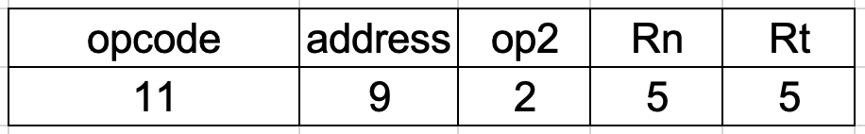
D-Type: Load and Store Instructions
Instruction fields
address Offset from base address
op2 Second register operand -256 to +255
Rn Base address (index register)
Rt Destination (load) / Source (store) register
LDUR R3, [R1, #126]
opcode | address | Op2 | Rn | Rt
 | #126 | N/A | X1 | X3
11111OOOO1O | OO111111O | OO | OOOO1 | OOO11
1111 1OOO O1OO O111 111O OOOO OO1O O011
F847E023

Slide 37
Common D-type Instructions
LDUR/STUR Rn, [Rt, off]
LDUR STUR LDXR STXR
LDURSW STURW LDURH STURH
LDURB STURB
LDUR/STUR Load and Store 64-bits, 8 bytes
LDURSW/STURSW Load and Store 32-bits, 4 bytes, signed word
LDURH/STURH Load and Store 16-bit, 2 bytes, half-word
LDURB/STURB Load and Store 8-bits, 1 byte
Op2 controls the selection of number of bytes to move

Slide 38
Load and Store limitations
Rn: Base address of the array
Address: Offset of the location to be stored or retrieved
Address is only 9 bits which means we can only index up to 2⁹ bytes (512) beyond the base address
STUR X3, [X1, #0] // X1[0] = X3
STUR X3, [X1, #80] // X1[10] = X3 8*10
STUR X3, [X1, #248] // X1[31] = X3 8 * 31 = 248
STUR X3, [X1, #512] // X1[64] = X3 8 * 64 = 512
To move to the next block of array elements we must increment X1 by 512 ADDI X1, X1, #512
OR Increment X1 by 8 for each time through your loop

Slide 39
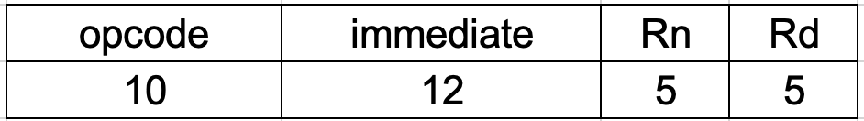
I-Type: Immediate Instructions
Instruction fields
immediate constant to be used for the 2nd operand. 12 signed bits. Can be -2048 to +2047
Rn 1st operand of the instruction
Rd Destination register
ANDI X3, X1, #0x1F
opcode | immediate | Rn | Rd
 | #0x1F | X1 | X3
1OO1OOO1OO | OOOOOOOO1111 | OOOO1 | OOO11
1OO1 OOO1 OOOO OOOO O111 11OO OO1O O011
91007C23

Slide 40
Common I-type Instructions
SUBI X4, X4, #1 // Decrement X4 by 1 X4--
ANDIS SUBIS ADDIS EORI
ANDI SUBI ADDI ORRI

Slide 41
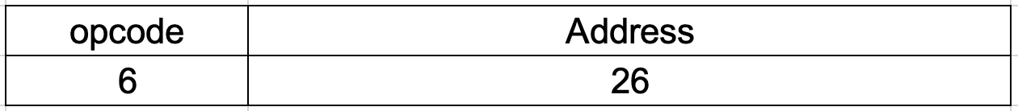
B and CB-Type: Branch and Compare Instructions
Instruction fields
Address +/-2²⁵ relative to the PC
B Exit
B Exit
opcode | Address
 | Exit. +819
000101 | OO OOOO OOOO OOOO OO11 OO11 OO11
0001 01OO OOOO OOOO OOOO OO11 OO11 OO11
14OOO333

Slide 42

CB-Type: Compare and Branch Instructions
Instruction fields
Address +/-2¹⁸ relative to the PC
CBNZ Exit, X15
CBNZ Exit , X15
opcode | Address | Rt
 | Exit. +819 | X15
1011 0101 | OOO OOOO OO11 OO11 OO11 | 01111
1O11 01O1 OOOO OOOO O11O O11O O110 1111
B500666F

Slide 43
CB-Type: Compare and Branch Instructions
Instruction fields
Address +/-2¹⁸ relative to the PC
B.GE Exit
The offset is shifted left by 2. Why?
B.GT Exit
Op code bits | Operation
O1O11 | B.LT
O11O1 | B.LE
O1O1O | B.GE
O11OO | B.GT
OOOOO | B.EQ
OOOO1 | B.NE
opcode | Address | Rt
 | Exit. +819 | .GT
O1O1 O1OO | OOO OOOO OO11 OO11 OO11 | 011OO
O1O1 01OO OOOO OOOO O11O O11O O110 11OO
5400666C

Slide 44
Common CB and B-type Instructions
SUBS XZR, X1, #45 // is X1 > 45
B.GT TooOld
SUBS X2, X1, #25 // is X1 equal to 25
CBZ JustRIght, X2
CBNZ CNZ
B.LE B.LT B.EQ B.NE
B.GE B.GT

Slide 45
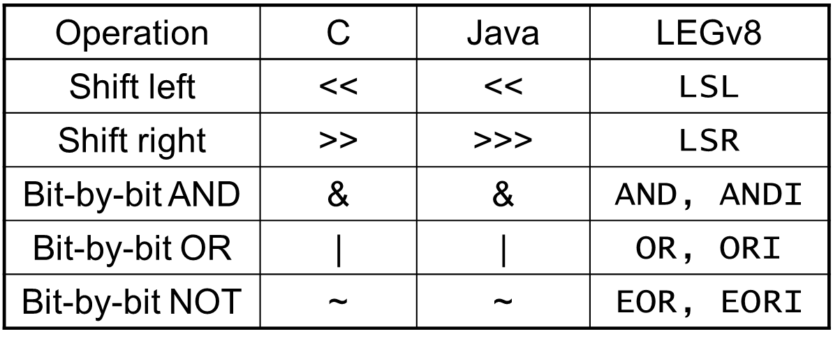
Shift and Logical Operations
Missing Logical Operations is NOT
Which can be accomplished with
EORI X4, X4, 0x0

Slide 46
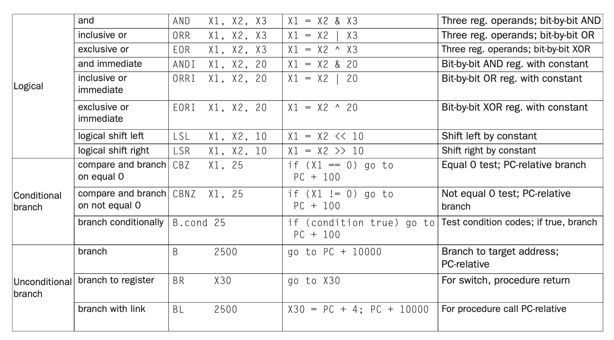

Slide 47
Shift operations (ADD, SUB, AND, OR)
opcode
Rm
shamt
Rn
Rd
11 bits
5 bits
6 bits
5 bits
5 bits
shamt: how many positions to shift – Shift Amount
Shift left logical
Shift left and fill with 0 bits
LSL by i bits multiplies by 2^{i}
For example consider the value 0000 1001 (=9₁₀)
Shift left by 3 positions: 0100 1000 (=72₁₀)
Shift right logical
Shift right and fill with 0 bits
LSR by i bits divides by 2^{i} (unsigned only, integer divide, no remainder)

Slide 48
Shift and Logical operations
2.18: X10 = AAAAAAAA X11 = 12345678
2.18.3: What is the value in X12 after executing
LSR X12, X10, #3
AND X12, X12, 0xFEF
1010 1010 1010 1010 1010 1010 1010 1010 (X10)
Right Shift by 3 positions
000 1010 1010 1010 1010 1010 1010 1010 1 gone 010
0001 0101 0101 0101 0101 0101 0101 0101
X12 = 0000 000 1555 5555 (in Hex)
0001 0101 0101 0101 0101 0101 0101 0101 =X12
0000 0000 0000 0000 0000 1111 1110 1111 =0xFEF
AND
0000 0000 0000 0000 0000 0101 0100 0101 =X12
= 0x 0545

Slide 49
OR
ORR X9, X10, X11
X10
00000000 00000000 00001101 11000000
X11
00000000 00000000 00111100 00000000
X9
00000000 00000000 00111101 11000000

Slide 50
AND
Useful to mask bits in a word
Select some bits, clear others to 0
AND X9, X10, X11
X10
00000000 00000000 00001101 11000000
X11
00000000 00000000 00111100 00000000
X9
00000000 00000000 00001100 00000000

Slide 51
NOT and Exclusive OR
You can build NOT (bit by bit complement) using XOR
If one of the source registers contains all 1’s
EORI X9, X10, #-1
X10
00000000 00000000 00000000 00000000 00000000 00000000 00001101 11000000
-1
11111111 11111111 11111111 11111111 11111111 11111111 11111111 11111111
X9
11111111 11111111 11111111 11111111 11111111 11111111 11110010 00111111

Slide 52
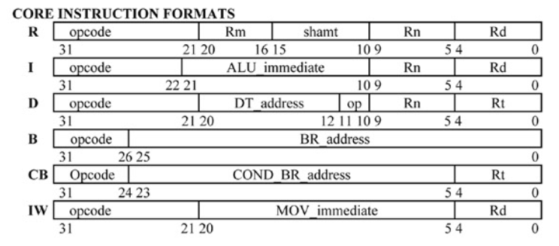
Core Instruction Formats

Slide 53
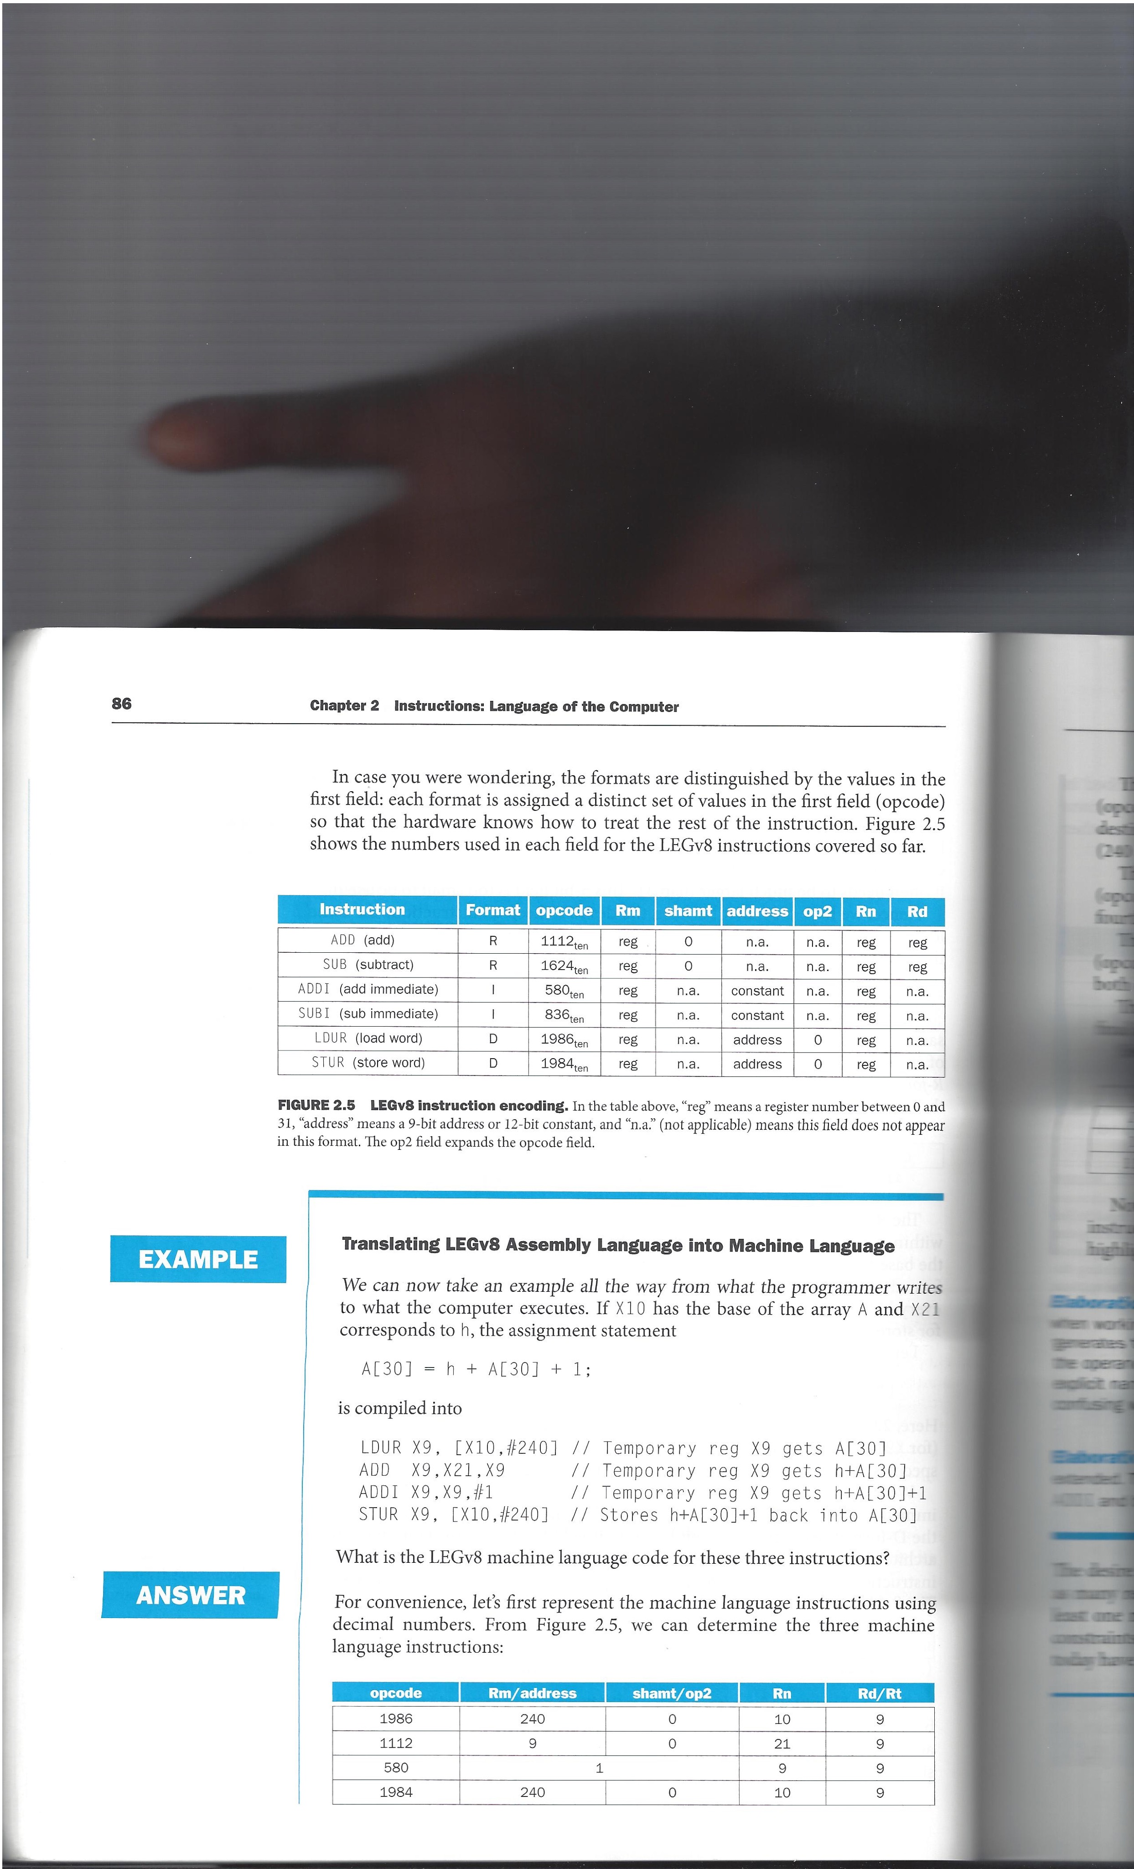
Converting Assembly to Machine code
Note the 2nd operation field (op2).
All LDUR/STUR have the same first operation value but op2 will indicate if we have 32 or 64 bit values
These are in decimal.
Need to convert them to binary

Slide 54
I Format – Hex to Instruction
Hex | Binary | OpCode | Type | Width
D100 042F | 11O1 OOO1 OOOO OOOO OOOO O1OO OO1O 1111 | 11O1OOO1OO SUBI | I | 10
ALU Immediate | Rn | Rd | Op
OOOOOOOOOOO1 | O1111 | OOOO1 | SUBI X1, X15, #1

Slide 55
D - Format – Hex to Instruction
Hex | Binary | OpCode | Type | Width
F800 03E3 | 11111OOOOOOOOOOO OOOOOO11111OOO11 | 11111OOOOOO STUR | D | 11
DT address | Op | Rn | Rt | Operation
OOOOOOOOO | OO | 11111 | OOO11 | STUR x3,[sp,#0]

Slide 56
R - Format – Hex to Instruction
Hex | Binary | OpCode | Type | Width
1E21 1843 | 0001111000100001 0001100001000011 | 00011110001 FDIVS | R | 11
Rm | Op2 | Rn | Rt | Operation
00001 | 000110 | 00010 | 00011 | FDIVS s3,s2,s1

Slide 57
I Format - EORI X11, X21, #42
Operation | Operator | OpCode | Type | Width
EORI. X17, X21, #27 | EORI | 11O1OO1OOO | I | 10
ALU Immediate #27 | Rn X21 | Rd X17
000000011011 | 10101 | 10001
Binary | Hex
11O1 OO1O OO00 0000 0110 111O 1O11 OOO1 | D200 6EB1

Slide 58
D Format - LDURB X10, [X5, #63]
Operation | Operator | OpCode | Type | Width
LDURB X10, [X5, #63] | LDURB | OO111OOOO1O | D | 11
DT Address #63 | op | Rn X5 | Rd X10
000111111 | 11 | 00101 | 01010
Binary | Hex
0011 1000 0100 0011 1111 110O 1O1O 1O10 | D200 6EAB

Slide 59
R – Format FADDD D8, D9, D10
Operation | Operator | OpCode | Type | Width
FADDD D8, D9, D10 | FADDD | OOO1111OO11 | R | 11
Rm D10 | FP Add | Rn D9 | Rd D8
O1O1O | OO1O1O | 01001 | 01000
Binary | Hex
OOO1 111O O110 1010 OO1O 1OO1 OO1O 1OOO | 1E6A 2928

Slide 60
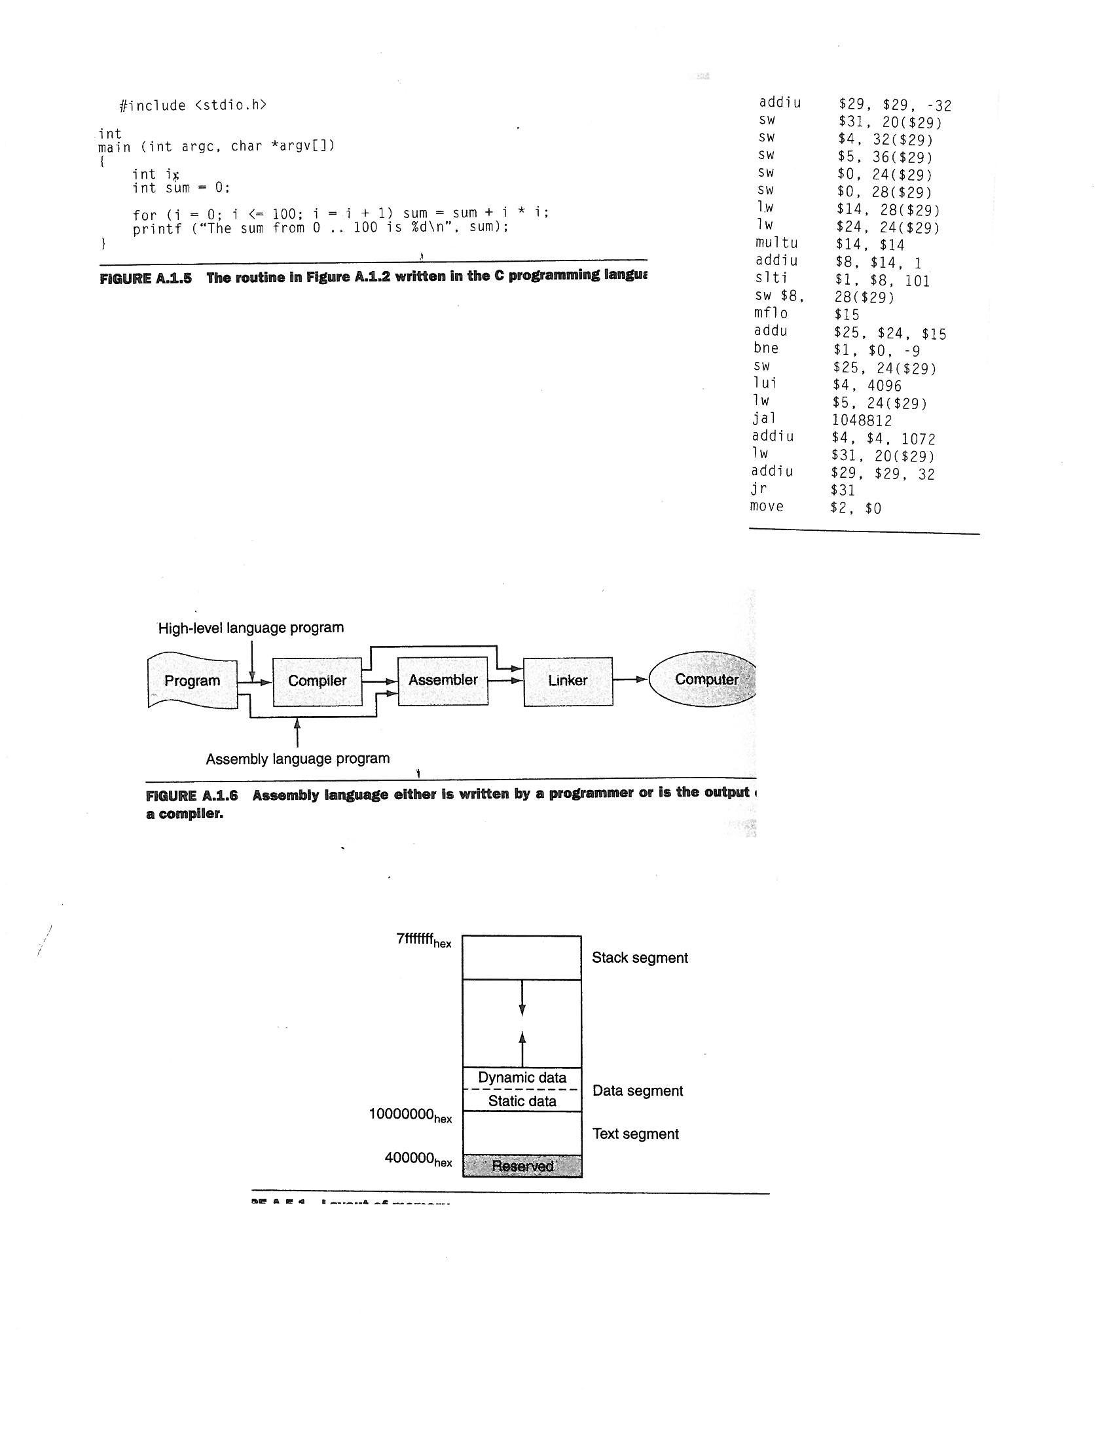
Memory Layout --> virtual memory
Program instructions must be stored in memory (stored program computers)
actually the same memory contains both instructions and data
Dynamic data relates to malloc, new, etc
Text segment = your code
Stack is for static variables and
for passing arguments to functions
Memory is “BYTE” addressable. Each byte has an address
A 64 bit integer data “occupies” 8 addresses

Slide 61
How data is stored in memory
Consider an array:
long long int b[8]; 64 bit data items
Each element of the array is 8 bytes.
Total size of the object b is 64 bytes
0
8
16
Starting address of an array
Or address of b[0]
24
32
b[1]
40
b[2]
48
b[3]
56
b[4]
64
b[5]
72
b[6]
80
b[7]
In general, the address of b[j] is given by
address of b[0] + (j) * 8
What if the array contains long int’s (32 bit per element)?
Address if b[j] = address of b[0] + (j) * 4
Later we will see how to find addresses of elements of 2 dimensional arrays such as b[j][k]
And structures

Slide 62
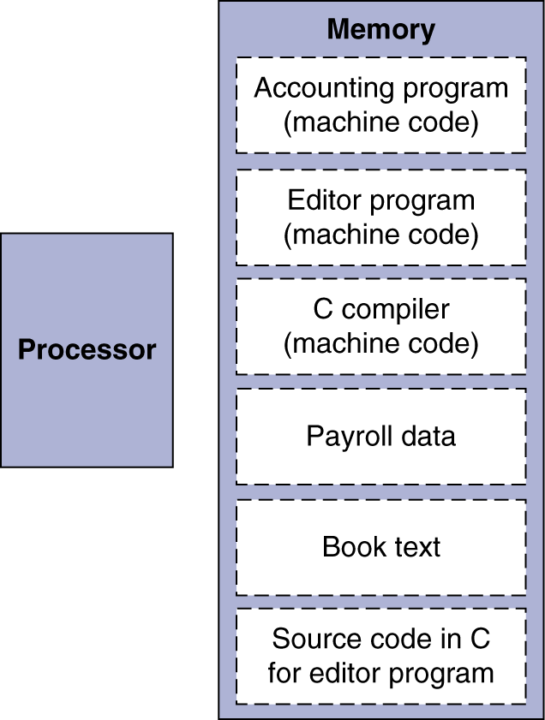
Memory Layout --> virtual memory
DRAM is shared by many users. So your text, data, stack, heap must be mapped to DRAM along with others
Physical Addresses vs Virtual Addresses

Slide 63
Memory Layout --> virtual memory
So we need to understand the difference between a virtual and physical address
Addresses generated by your program (either instruction address, or address generated by a
Load or Store) are virtual addresses
For now we will not worry about the difference between virtual address (VA) and physical addresses (PA). We will talk about how VA are translated to PA later
Instructions represented in binary, just like data
Programs can operate on programs
Your code may be data for another program (viz. compiler, optimizer)
Binary compatibility allows compiled programs to work on different computers
Standardized ISAs
LEGv8 and ARMv8 instructions
Encoded as 32-bit instruction words
Small number of formats encoding operation code (opcode), register numbers, …
Regularity!
We increment PC (pointer to instruction being executed) by 4!

Slide 64
How data is stored in memory
struct foo {
char a;
long int b;
bool c;
long long d;
int e;
float f;
long long g;
char * cptr;
float *fptr;
long int x;
};
I will assume long int is a 32 bit number, int is a 16 bit number
long long int is 64 bits and floating point numbers (float) are 32 bits
All pointers are 64 bits long (addresses)
Characters (char) and bool data takes 1 byte
 |  |  |  | BYTE ADDRESS
 | 7 | 6 | 5 | 4 | 3 | 2 | 1 | 0
word 0 | b | b | b | b | * | * | * | a
word 1 | * | * | * | * | * | * | * | c
word 2 | d | d | d | d | d | d | d | d
word 3 | f | f | f | f | * | * | e | e
word 4 | g | g | g | g | g | g | g | g
word 5 | cptr | cptr | cptr | cptr | cptr | cptr | cptr | cptr
word 6 | fptr | ftpr | fptr | fptr | fptr | fptr | fptr | fptr
word 7 |  |  |  |  | x | x | x | x
Starting address of foo
Data alignment: 8 byte data must start at an address that is a multiple of 8
4 byte data must start at an address that is a multiple of 4
2 byte data must start at an address that is a multiple of 2

Slide 65
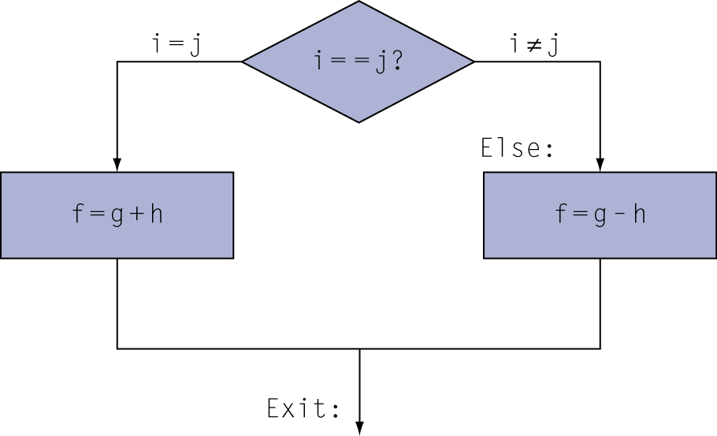
Branch and Conditional Branch Code Examples
Let us see how we can use branch and conditional branch instructions
Let us convert the following C code to LEGv8
if (i == j) f = g + h; else f = g - h;
Assume f in X19, g in X20, h in X21, i in X22 and j in X23
Compiled LEGv8 code:
SUB X9,X22,X23
CBNZ X9,Else
ADD X19,X20,X21 //then
B Exit
Else: SUB X19,X20,x21
Exit:
Observe the difference in the flow in C and
Assembly code.
In assembly, if the condition is true, you DO NOT
execute the instruction that immediately follows
But go to a new instruction given by the label
we reverse the condition in Assembly to follow the same flow as in C

Slide 66
Another Conditional Example
if (a==0)
if (b==0) c = v[0];
else c=v[1];
else if (a==1) c = v[2];
LDUR X4, [X0, #0] // X4 = a
LDUR X5, [X1, #0] // X5 = b
CBNZ X4, Outside-else // Check if a = 0
CBNZ X5, Inside-else // Check if b = 0
LDUR X6, [X3, #0] // X6=v[0]
STUR X6, [X2, #0] // c = X6 = v[0]
B Exit-If // leave if statement
Inside-else: LDUR X6, [X3, #8] // X6 = v[1]
STUR X6, [X2, #0] // c = X6 = v[1]
B Exit-If // leave if statement
Outside-else: SUB X7, X4, #1 // X7 = X4 – 1
CBNZ X7, Exit-If // check if X7 is zero (or a= 1)
LDUR X6, [X3, #16] // X6 = v[2]
STUR X6, [X2, #0] // c = X6 = v[2]
Exit-if:
Let us assume the
address of a in X0
address of b in X1
address of c in X2
address of v in X3

Slide 67
Another Conditional Example
Two types of conditional instructions
CBNZ and CBZ → can be used to check if a value is zero or non-zero
CBNZ X1, else or CBZ X1, then
Or we can have
B.EQ, B.NE, B.LT, B.GT, B.LE, B.GE
These actually consists of two instructions
SUBS XZR, X1, X2 //set condition codes
B.EQ else //if result of previous SUB is zero or X1=X2 branch
Or
SUBS XZR, X1, X2 //set condition codes
B.GT else // if result of SUB is positive or X1 > X2

Slide 68
Compiling Loop Statements
C snippet:
while (save[i] == k) i = i+1;
i in X22, k in X24, address of save in X25 → address of save[0],
elements of save are 64-bits each
LEGv8 code:
Loop: LSL X10, X22, #3 //Multiply i*8 (X10 = i*8)
// you can use MUL X10, X22, #8 ADD X10, X10, X25 //X10 = X10+ i*8 or address of savi[i] LDUR X9, [X10, #0] //X9 =save[i] SUB X11, X9,X24 // check save[i] == k CBNZ X11, Exit //If false, exit
ADD X22, X22, #1 //else i++
// ARMv8, use ADD X22, X22, #1
// LEGv8 uses ADDI, X22, X22, #1 B Loop //Loop back and repeat Exit:

Slide 69
Another Loop Example
Consider the first sample ARM assembly program
.data
.type v, %object
.size v, 3
v:
.xword 1, 2, 3
.text
.global main
.arch armv8-a+fp+simd
.type main, %function
main:
ADRP X0, v
ADD X0, X0, :lo12:v
LDUR X1, [X0, #0]
LDUR X2, [X0, #8]
ADD X1, X1, X2
LDUR X2, [X0, #16]
ADD X1, X1, X2 //X1 = v[0]+v[1]+v[2]
exit:
Note we are doing v[0]+v[1]+v[2]
Instead let us rewrite this as a loop
sum = 0;
for (i=0; i<n; i++) sum = sum + v[i];

Slide 70
Another Loop Example
sum = 0;
for (i=0; i<n; i++) sum = sum + v[i];
i in X3, n in X4 and sum in X1
.data
.type v, %object
.type n, %object
.size v, 4
.size n, 1
n: .xword 4 // define the size of the array or n
v: .xword 1, 2, 3, 4, // define array values
.text
.global main
.arch armv8-a+fp+simd
.type main, %function
main: ADRP X0, v // get the address of array v into X0
ADD X0, X0, :lo12:v
ADRP X4, n // get the address of n into X4
ADD X4, X4, :lo12:n
LDUR X4, [X4, #0] // load n into X4 —note address of n is lost
SUB X3, X3, X3 // initialize i to zero (we could use ADD X3, XZR, #0)
SUB X1, X1, X1 // initialize X1 (sum) to zero [could use ADD X1, XZR, #0]
loop: LDUR X2, [X0,#0] // load v[i] into X2
ADD X1, X1, X2 // sum = sum+v[i]
ADD X3, X3, #1 // i = i+1
ADD X0, X0, #8 // get the address of next array element
SUB X5, X4, X3 // check if i < n
CBNZ X5, loop // if i < n repeat the loop (could use BLT loop)
exit:

Slide 71
More examples using condition codes
C Code Snippet:
if (a > b) a = a+1;
Assume that a in X22, b in X23
LEGv8 Code:
SUBS X9, X22, X23 //Use sub to make comparison and set condition codes
// note we are not checking the value in X9, only condition
// codes set by the SUBS instruction
B.LE Exit //Conditional branch if X22 is < = X23
ADD X22, X22, #1 // a = a +1 (In ARBv8 use ADD X22, X22, #1
// in LEGv8 we use ADDI X22, X22, #1
Exit:
Note: LE can be checked to see if either the Zero OR Negative bits are set
In general we need to Store results from registers back to variable (in memory)
just as we need to Load variable values from memory to registers

Slide 72
More examples using condition codes
for (i=0, i<a, i++) b[i] = a + i;
a is in X22, Base address array b is in X23
ADD X9, XZR, #0 //Set i=0 (i is in X9)
//this is another way to initialize a value to zero
// – note we could also use SUB X9, X9, X9
Loop: SUBS X10, X9, X22 //Check for i < a and set condition codes
B.GE Exit //If false exit else continue
ADD X10, X22, X9 //Compute a + i
LSL X11, X9, #3 //Multiply i*8
// you can also use MUL X11, X9, #8
ADD X11, X23, X11 //Compute address for b[i]
STUR X10, [X11, #0] //Store the a + i in b[i]
ADD X9, X9, #1 //i++
B Loop //Loop back
Exit:
We can write loops by performing Exit test at the top or at the bottom.
If you do bottom testing, loop is executed at least ONCE

Slide 73
Core Instruction Formats

Slide 74
Instruction Modifiers
Some instructions start with an F or end with I and/or S
F indicates a Floating Point operation
I uses an ‘immediate’ (constant) value for the 2nd operand
S sets the Condition Codes

Slide 75
Binary representation of Instructions
Instructions have several ‘patterns’
Operation Destination, Source1, Source2 {,optional}
Soiurce1 is always a Register
Source2 is either a register or an ‘immediate’ value (constant)

Slide 76
Binary representation of Instructions
Instructions have several ‘patterns’
Load/StoreOp DataReg, [BaseAdrs Reg, Offset]
DataReg Register holds value to be stored or loaded
BaseAdrsReg Address of memory location
Offset Offset from BaseAdrs to load/store data

Slide 77
Binary representation of Instructions
Instructions have several ‘patterns’
Branch Destination
Branch.Condition Destination
Branch Changes PC to specified destination
Destination Offset +/- from the current PC
Condition Based on condition codes executes the branch or not. .LE, .EQ, LT, .GT, .NE

Slide 78
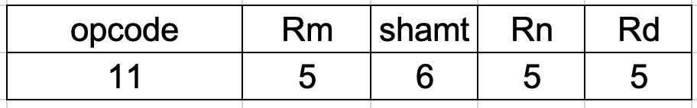
R-Type: Arithmetic and Logic Instructions
Instruction fields
Rm First register operand
Rn Second register operand
Shift Amount Shift Rn left n bits before doing the op
Rd Destination register
ADD R5, R9, R20
opcode | Rm | shamt | Rn | Rd
 | X20 | N/A | X9 | X5
1OOO1O11OOO | 1O1OO | OOOOOO | O1OO1 | OO1O1
1OOO 1O11 OOO1 O1OO OOOO OOO1 OO1O O1O1
8B140125

Slide 79
R-Type: Arithmetic and Logic Instructions
Instruction fields
Rm First register operand
Rn Second register operand
Shift Amount Shift Rn left n bits before doing the op
Rd Destination register
ADD R5, R9, R20, LSL 12
opcode | Rm | shamt | Rn | Rd
 | X20 | N/A | X9 | X5
1OOO1O11OOO | 1O1OO | OO11OO | O1OO1 | OO1O1
1OOO 1O11 OOO1 O1OO OO11 OOO1 OO1O O1O1
8B143125

Slide 80
Common R-type Instuctions
ADD Rd, Rm, Rn
LDURD STURD SUBS ANDS
BR LSL LSR SUB
EOR LDURS STURS ADDS
ORR UMULH SMULH MUL
SDIV UDIV ADD AND
FADDD FCMPD FDIVD FMULD
FSUBD FADDS FCMPS FDIVS
FMULS FSUBS
Unsigned Sets CC Bit operators

